Slide 1
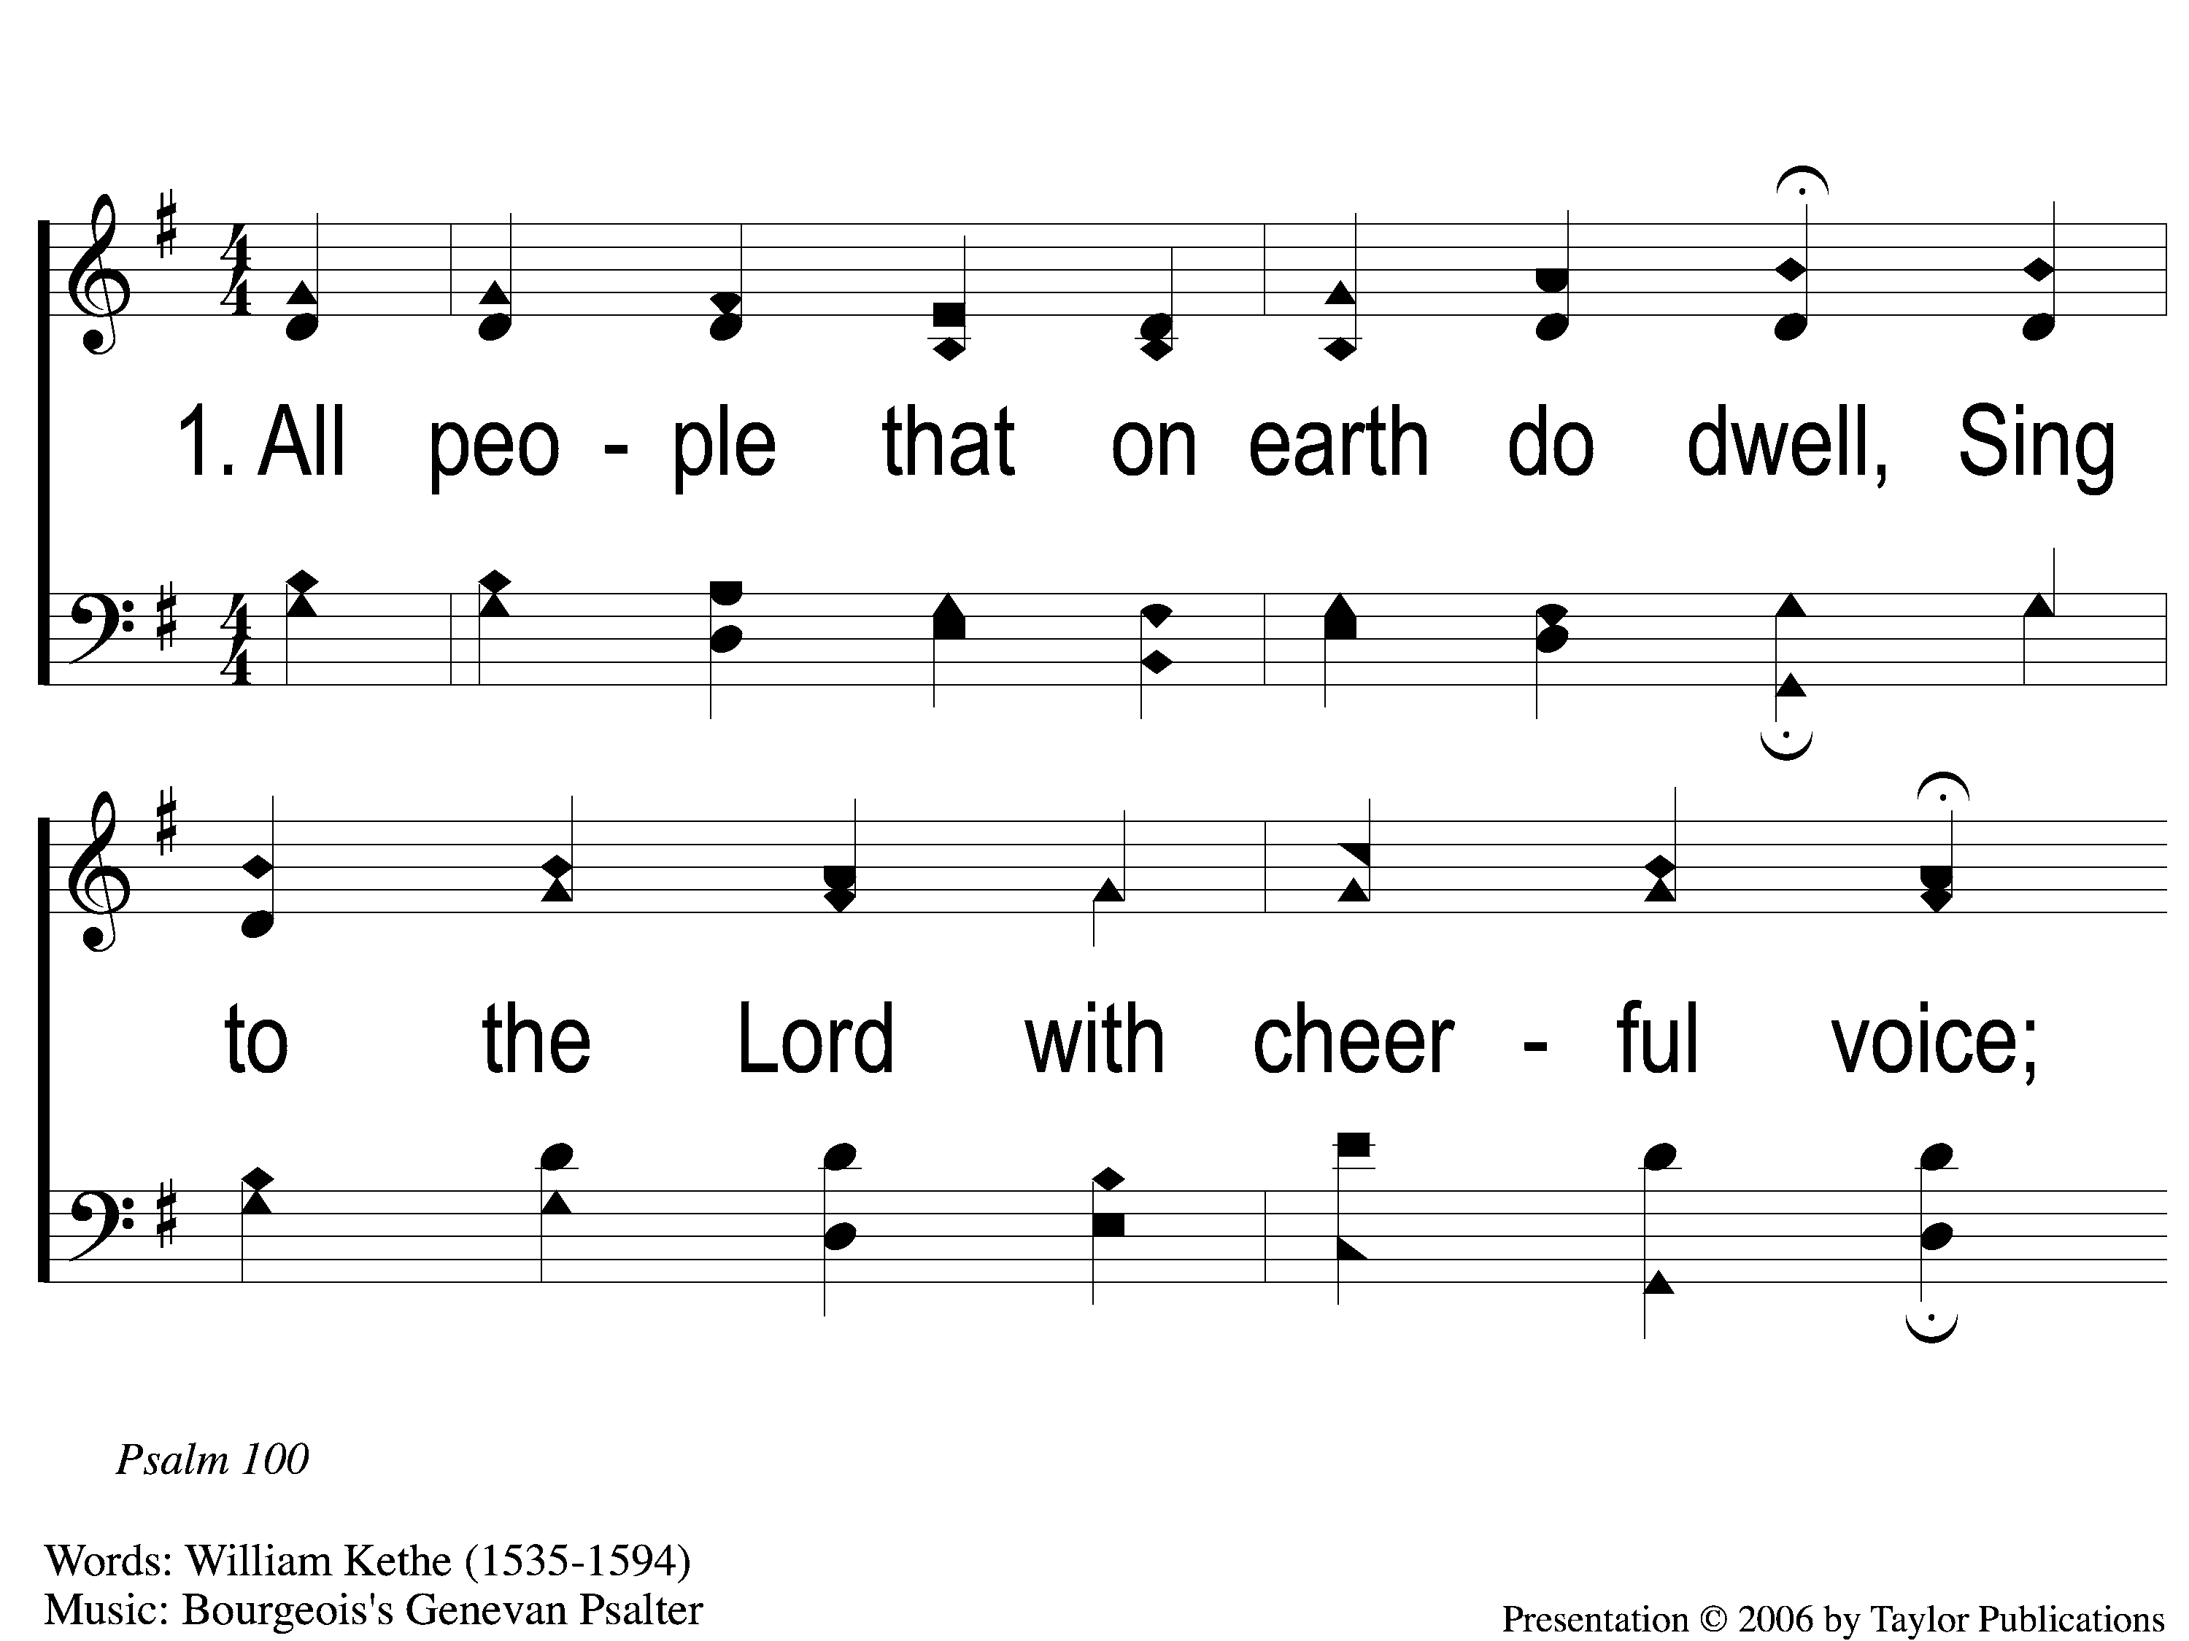
1-1 All People That on Earth Do Dwell
All People That on Earth Do Dwell
532

Slide 2
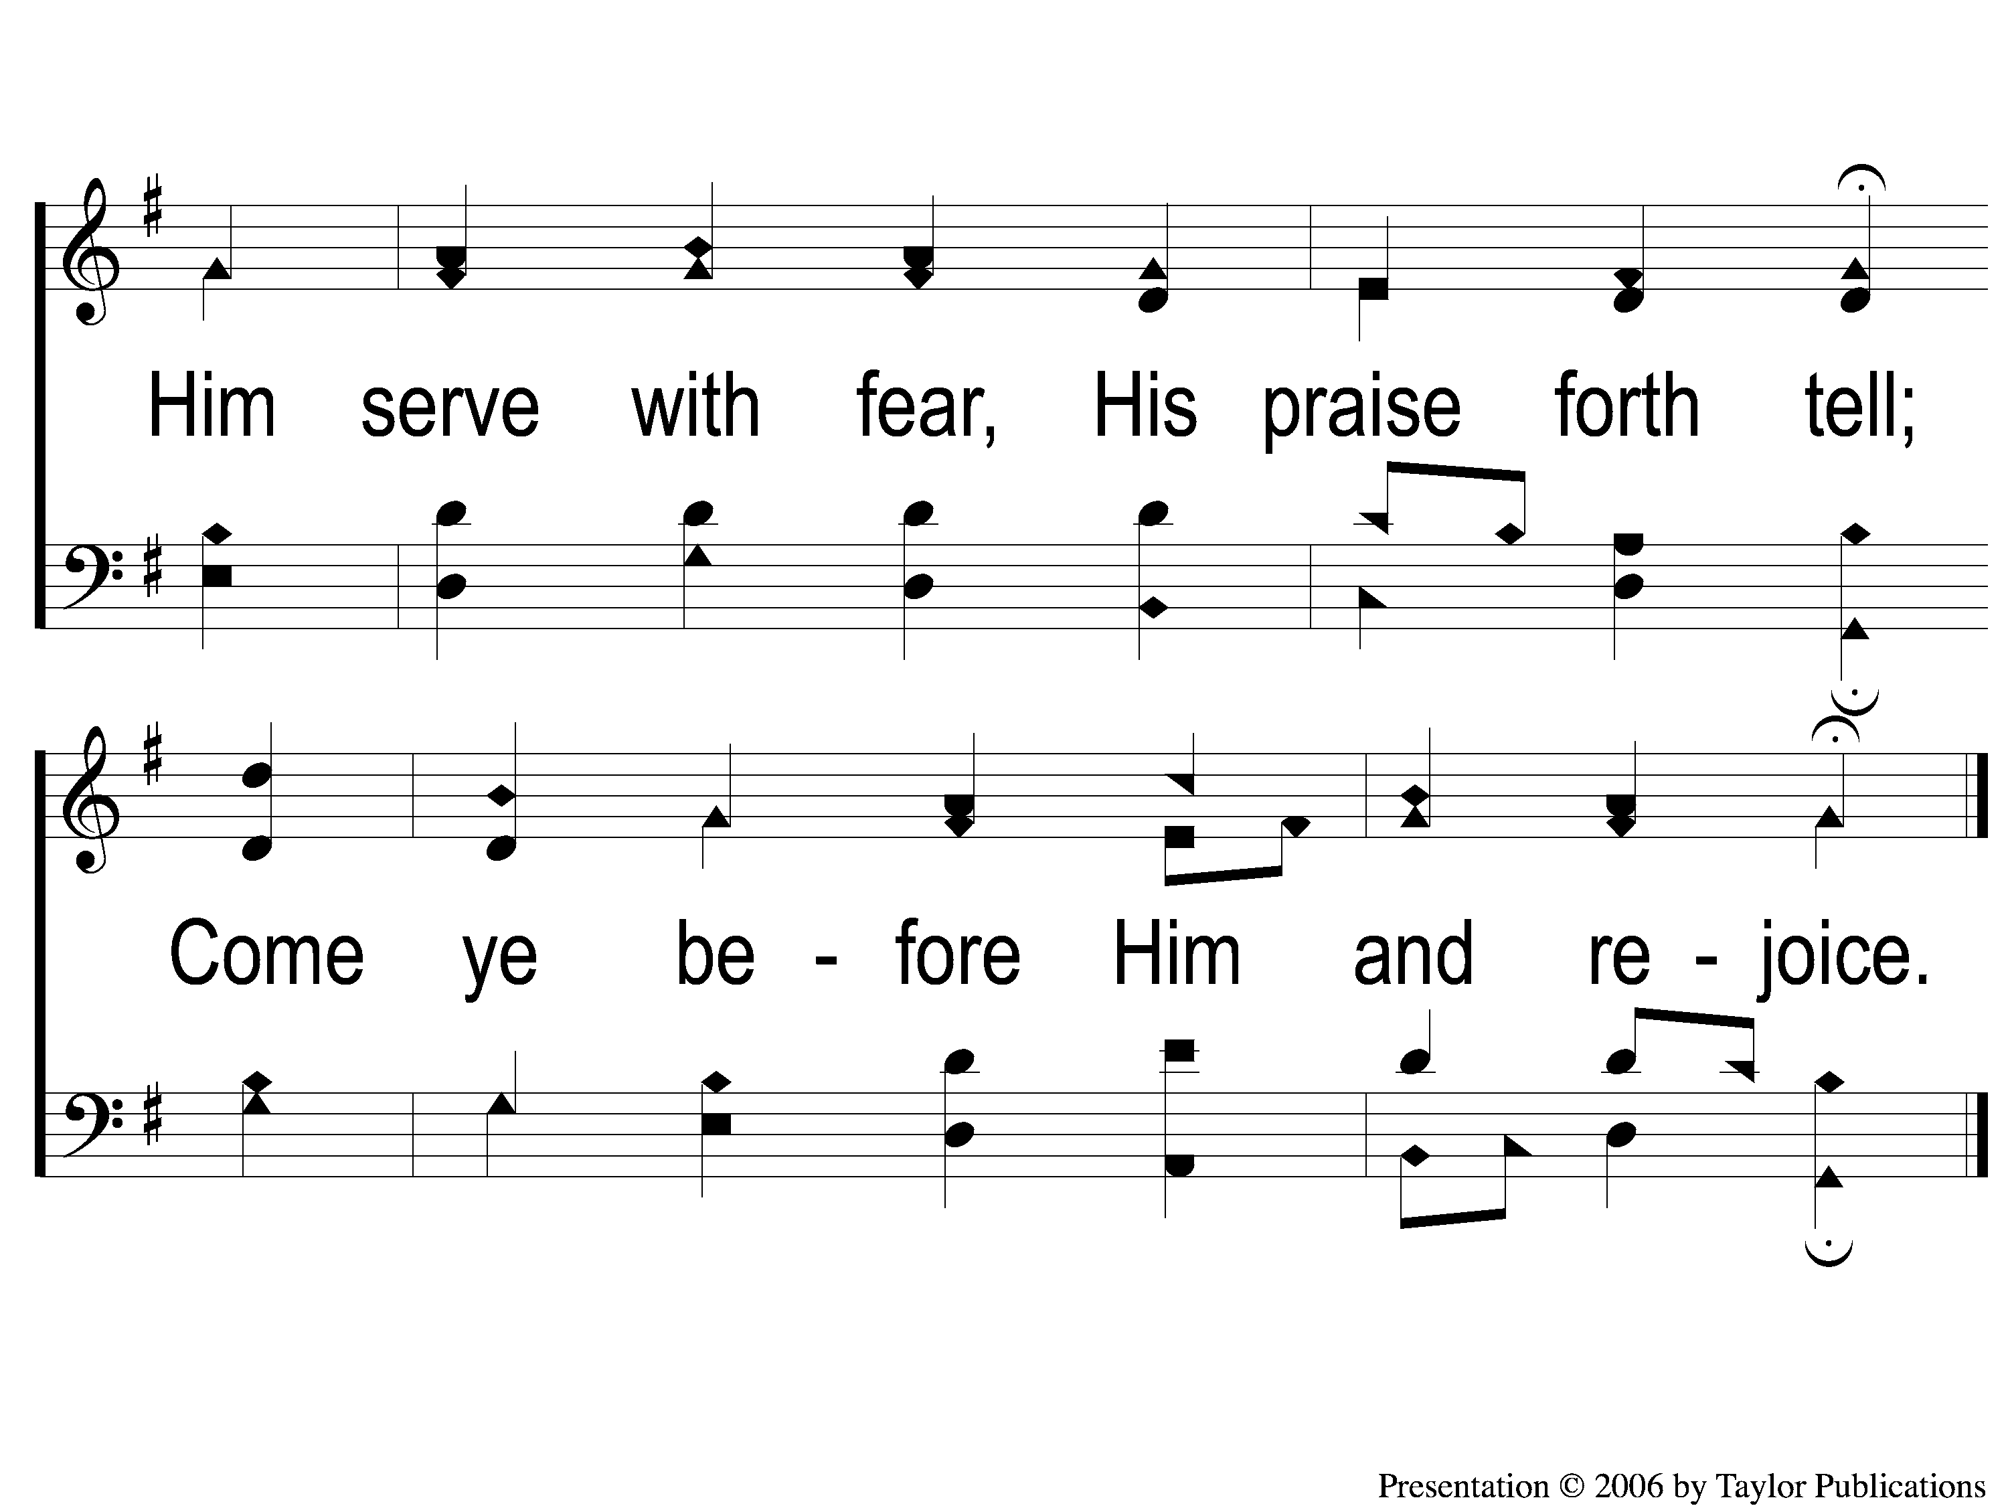
1-2 All People That on Earth Do Dwell
All People That on Earth Do Dwell
532

Slide 3
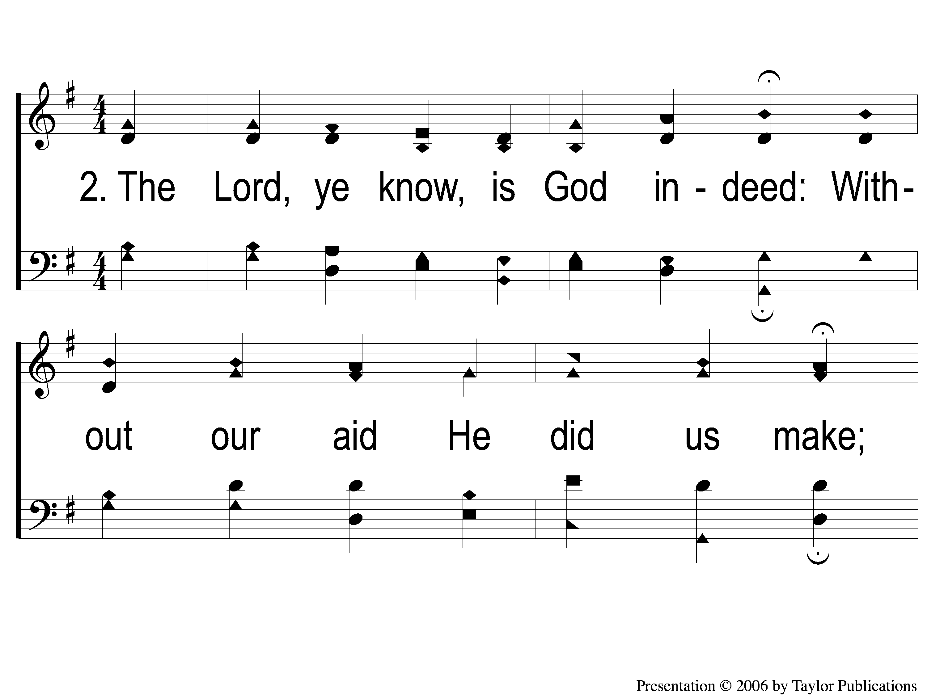
2-1 All People That on Earth Do Dwell
All People That on Earth Do Dwell
532

Slide 4
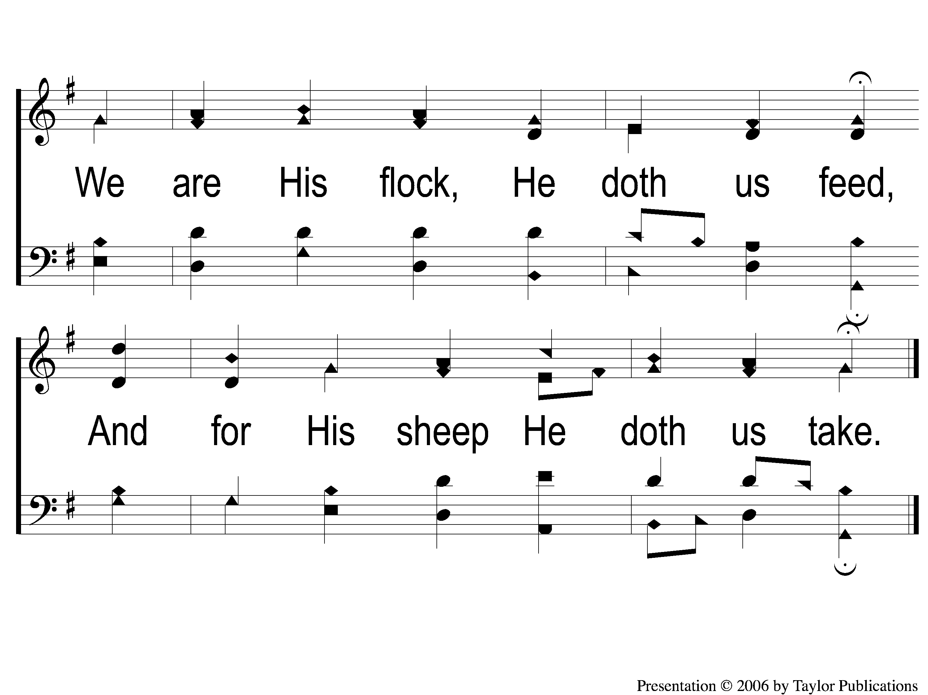
2-2 All People That on Earth Do Dwell
All People That on Earth Do Dwell
532

Slide 5
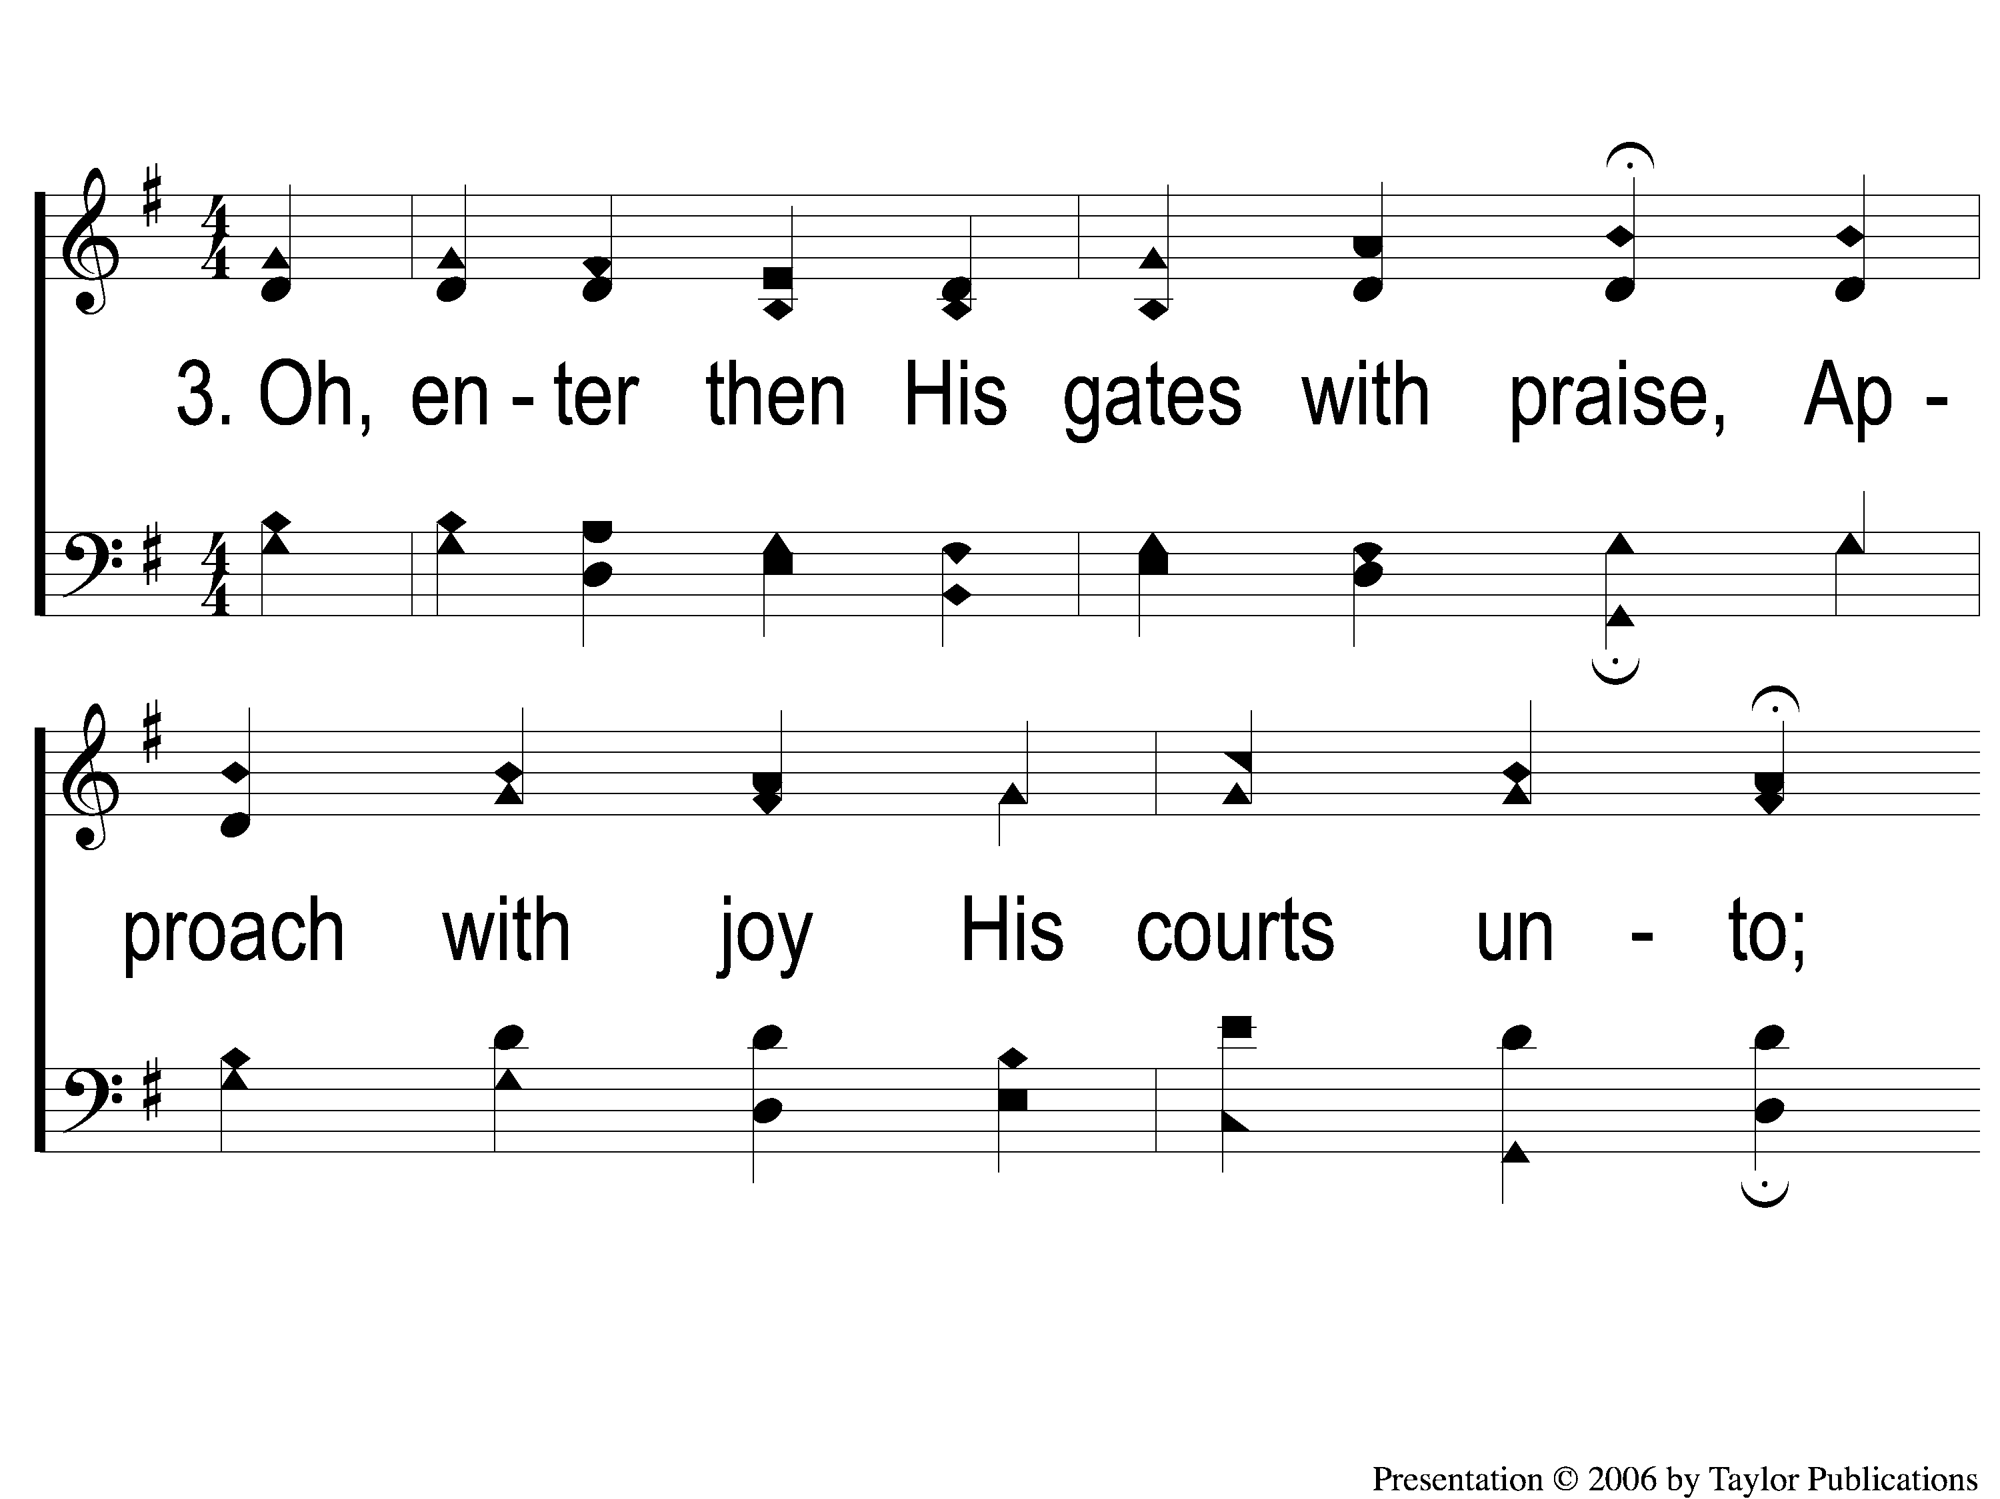
3-1 All People That on Earth Do Dwell
All People That on Earth Do Dwell
532

Slide 6
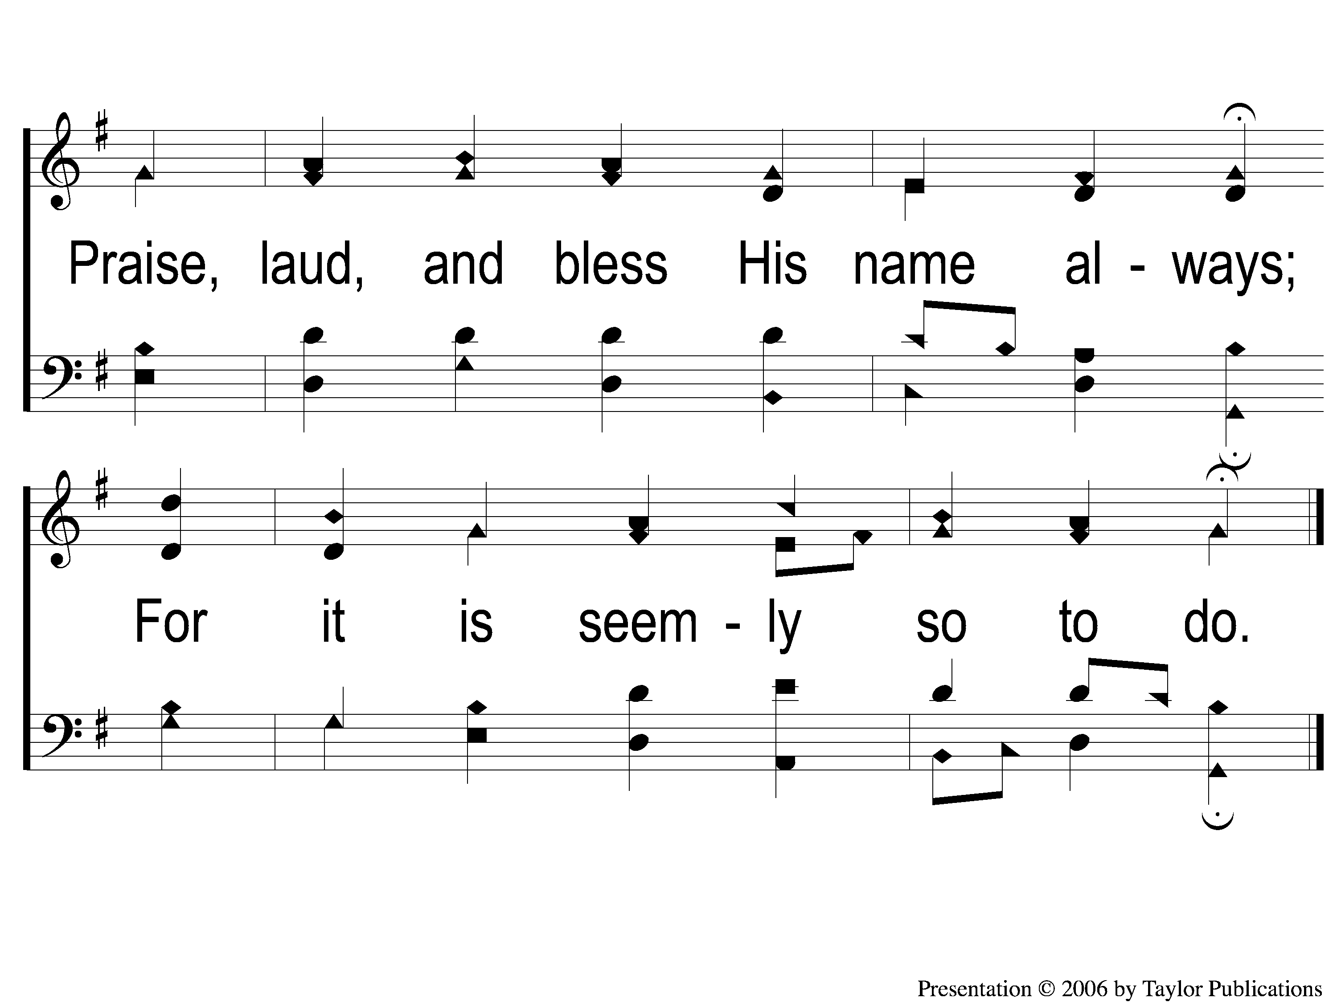
3-2 All People That on Earth Do Dwell
All People That on Earth Do Dwell
532

Slide 7
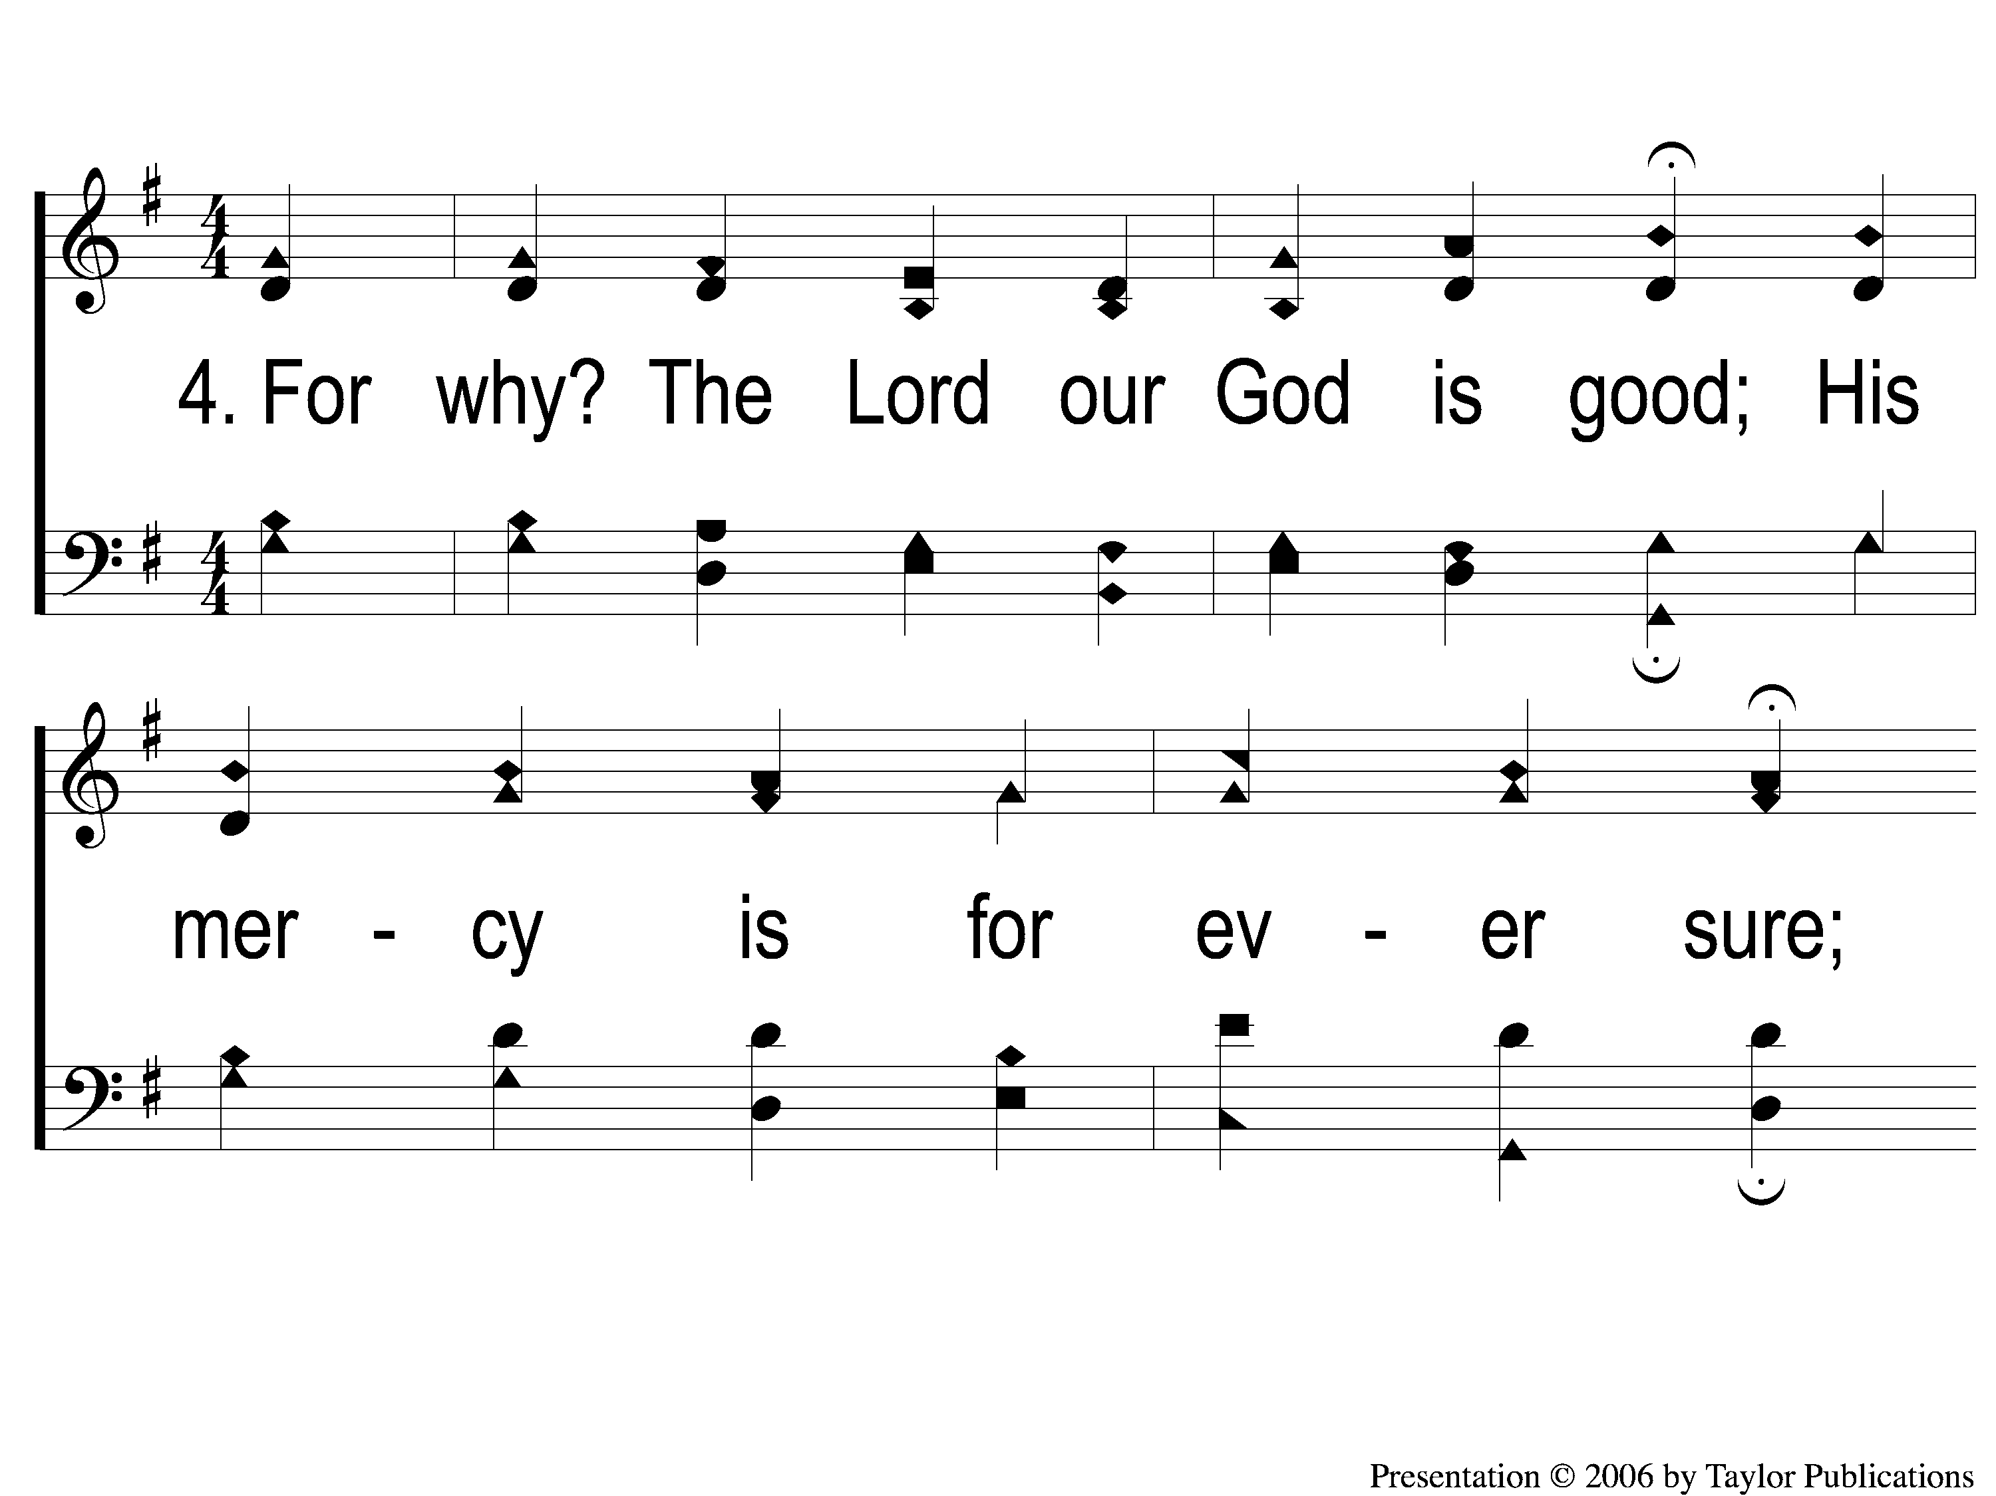
4-1 All People That on Earth Do Dwell
All People That on Earth Do Dwell
532

Slide 8
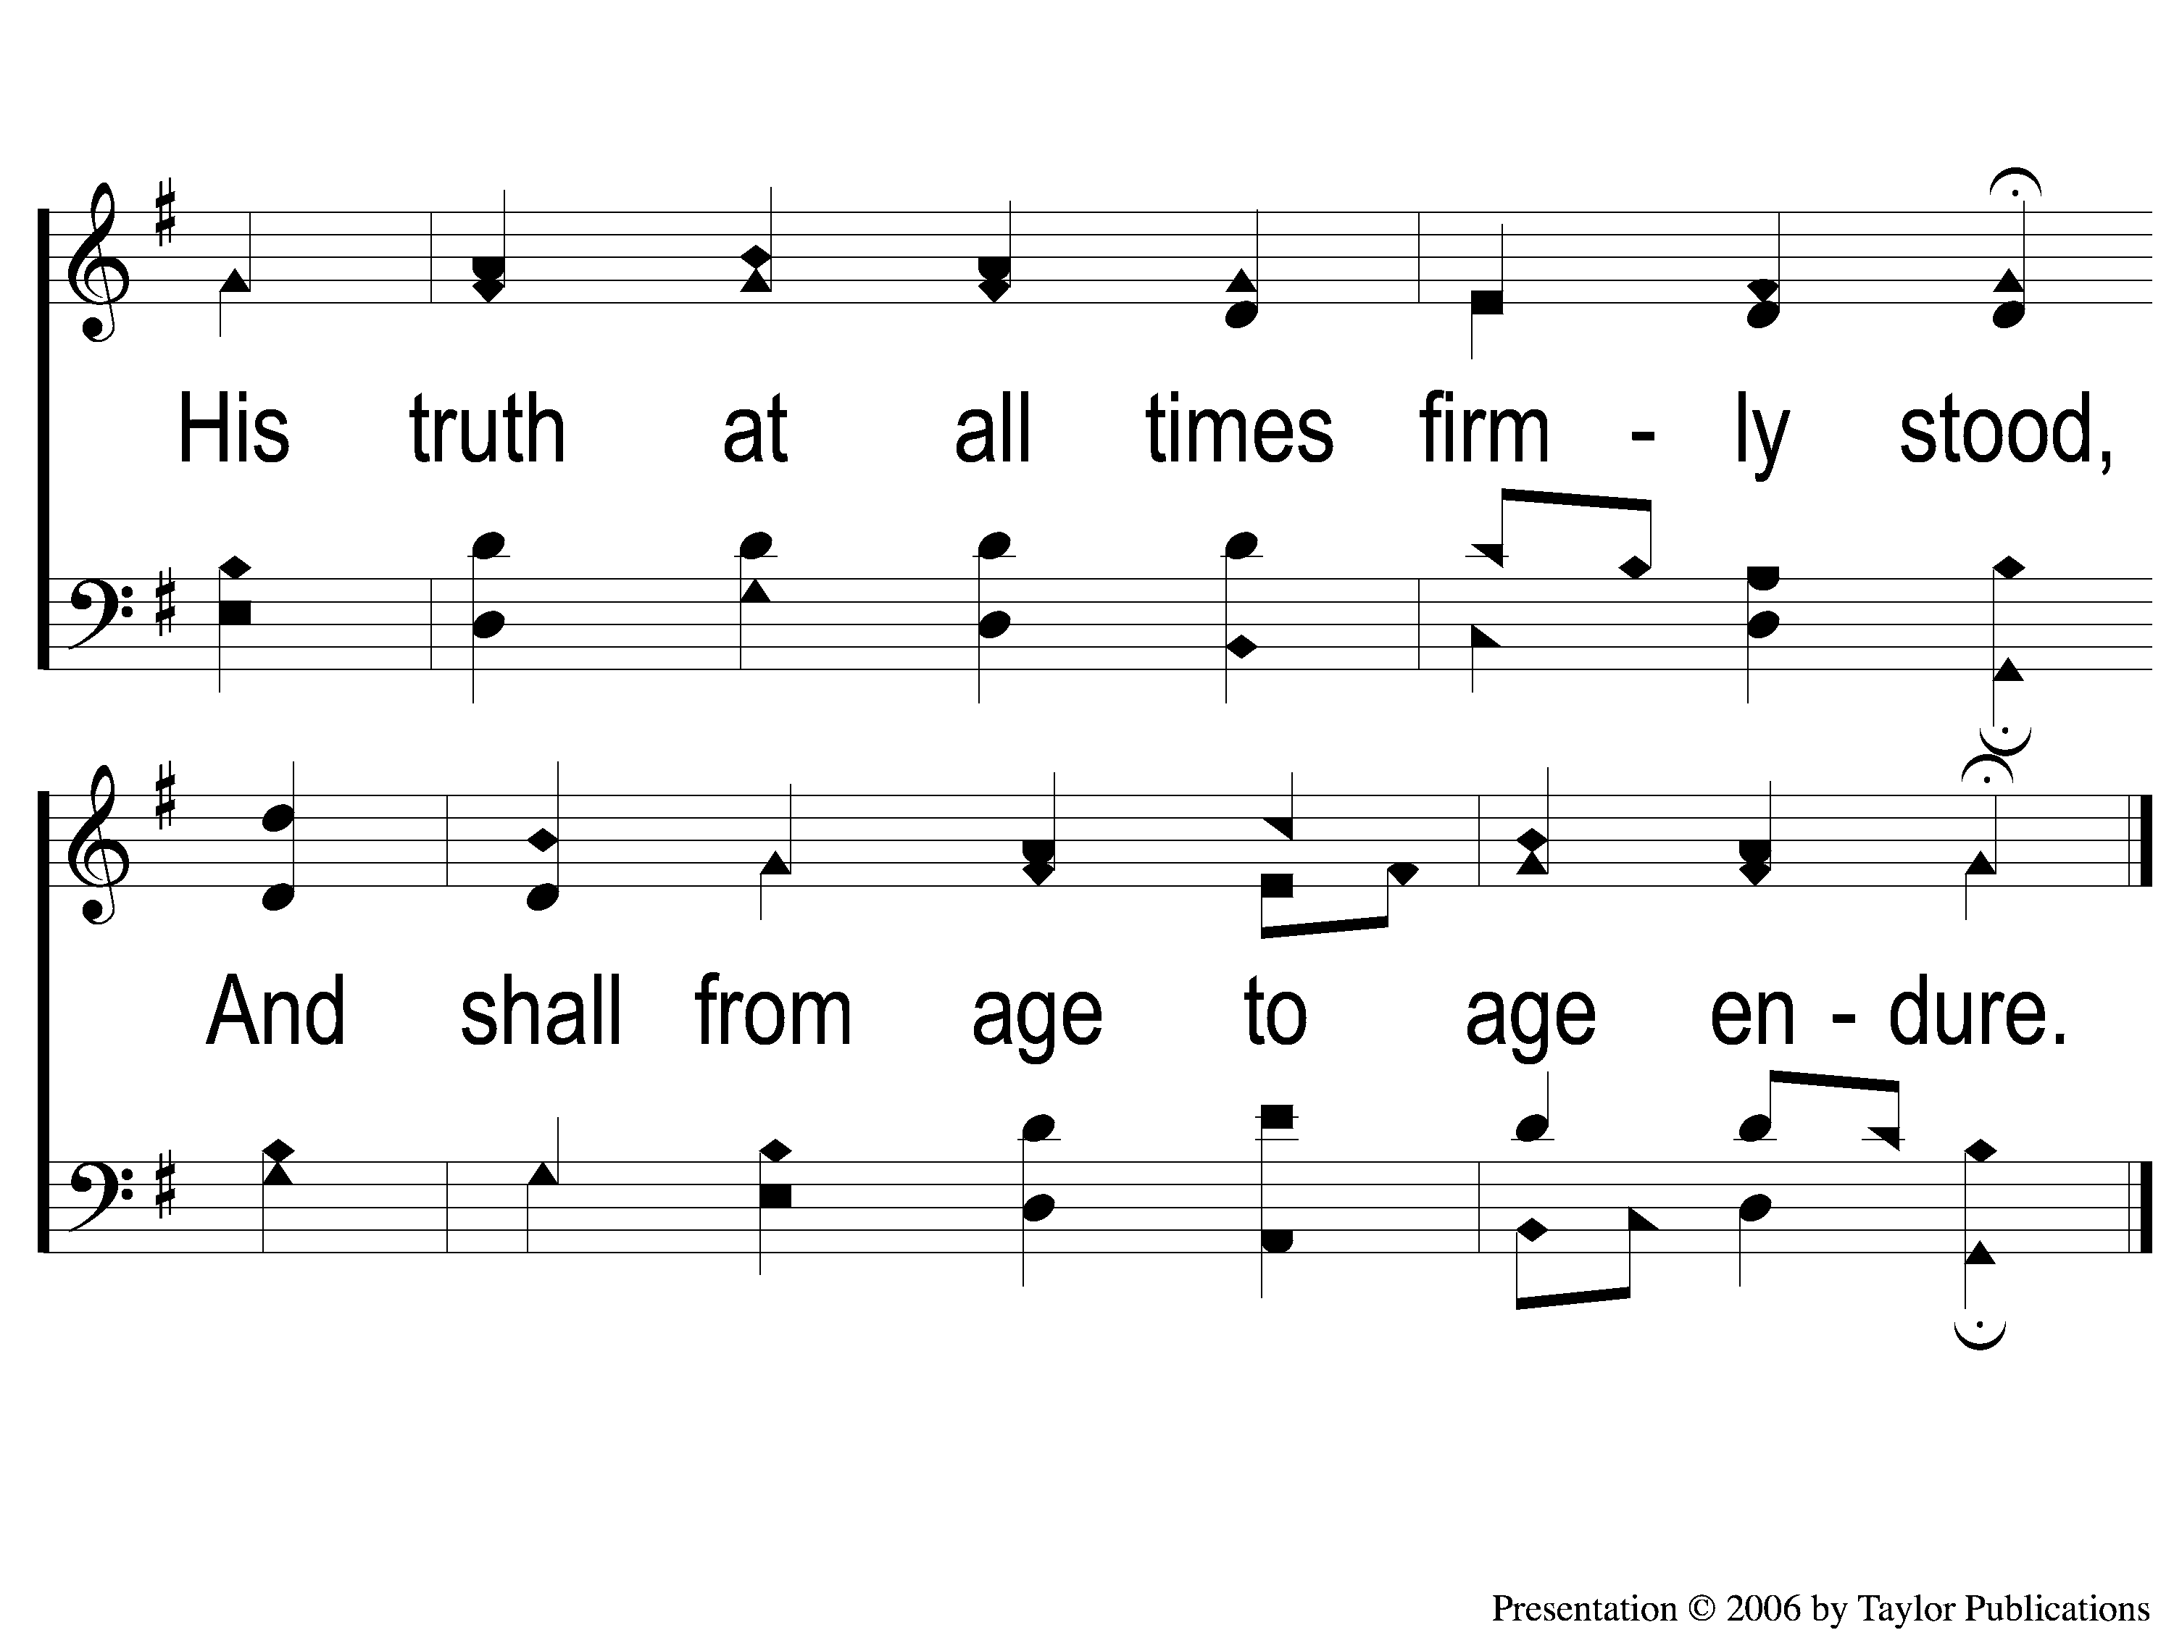
4-2 All People That on Earth Do Dwell
All People That on Earth Do Dwell
532

